Slide 1

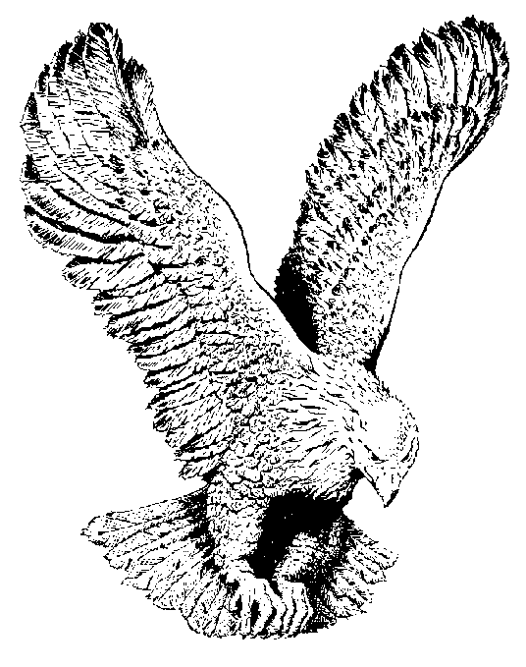
97
THIS WORLD CAN’T HOLD ME
This old world can never hold me,
Any moment I’ll be gone,
For I’ve made my consecration,
And I have the wedding garment on.

